Slide 1
PRIVACY ENHANCED MAIL
Network Security | Group No. 4 | CA-3
SIT, Pune (2021-25)

Slide 2
MEMBERS OF GROUP NO. 4
DR. SONALI KOTHARI
ARGHADEEP DAS
KASHISH MEHTA
SANGEET AGRAWAL
VAISHNAVI BHOIR
GUIDE
PRN. 21070122023
PRN. 21070122073
PRN. 21070122140
PRN. 21070122199

Slide 3
TABLE OF CONTENTS
1. WHAT IS PEM?
2. KEY FEATURES
3. MECHANISM
4. APPLICATIONS
5. CASE STUDY
6. CHALLENGES
7. FUTURE TRENDS
8. SUMMARY & REFERENCES

Slide 4
WHAT IS PEM?
Privacy Enhanced Mail (PEM) is a suite of protocols designed to secure email communications over the internet.
Developed in response to growing concerns over email security, PEM provides mechanisms to protect the confidentiality, integrity, and authenticity of messages sent via email.
It utilizes various cryptographic techniques, including encryption and digital signatures, to safeguard sensitive information from unauthorized access and alterations during transmission.

Slide 5

SIGNIFICANCE OF PEM
With the rise of cyber threats and the increasing amount of sensitive information shared via email, the security of email communications has become paramount.
PEM offers a robust solution by providing mechanisms that ensure the confidentiality, integrity, and authenticity of email messages.
Implementing PEM allows individuals and organizations to communicate sensitive information with confidence, knowing that their communications are protected against unauthorized access and potential data breaches.
Notes:
Before PEM, email communications were generally sent in plain text, leaving sensitive information exposed to interception, eavesdropping, and tampering. PEM was one of the first formalized efforts to secure email, setting an important precedent for the need for encryption and authentication in email systems.

Slide 6
KEY FEATURES OF PEM
Confidentiality:
Protects email content from unauthorized access using encryption techniques.
Integrity:
Maintains data consistency throughout its lifecycle by detecting unauthorized changes via message digests.
Authentication:
Confirms the identity of the sender through digital signatures, ensuring that the message comes from a legitimate source.

Slide 7
MECHANISM OF PEM
1. Canonical Conversion
2. Digital Signature
4. Base64 Encoding
3. Encryption
Notes:
Sangeet

Slide 8
1. CANONICAL CONVERSION
Definition:
The process of converting messages into a standard format to ensure compatibility across different systems.
Purpose:
Prevents discrepancies in message digest generation due to variations in computer architectures or operating systems.
Importance:
Ensures that both sender and receiver interpret the message consistently, maintaining the integrity of the email.
Notes:
Sangeet

Slide 9
2. DIGITAL SIGNATURE
Definition:
A digital signature is created by encrypting the message digest with the sender’s private key.
Purpose:
Confirms the sender’s identity and ensures that the message has not been altered during transmission.
Importance:
Enhances trust in email communications by providing a verifiable means of authentication.
Notes:
Arghadeep

Slide 10
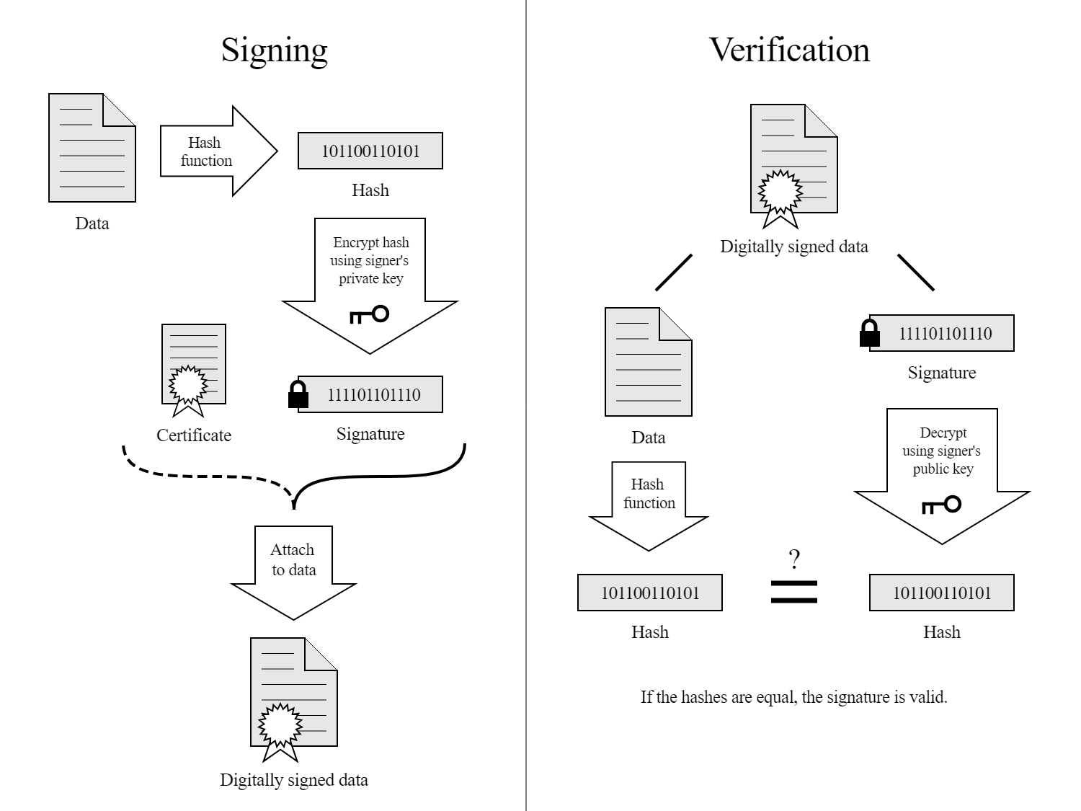
Notes:
Arghadeep

Slide 11
3. ENCRYPTION
Definition:
The process of encoding the original message and digital signature using a symmetric key.
Purpose:
Ensures confidentiality by preventing unauthorized access to the message content.
Importance:
Protects sensitive information during transmission, making it readable only by the intended recipient.

Slide 12
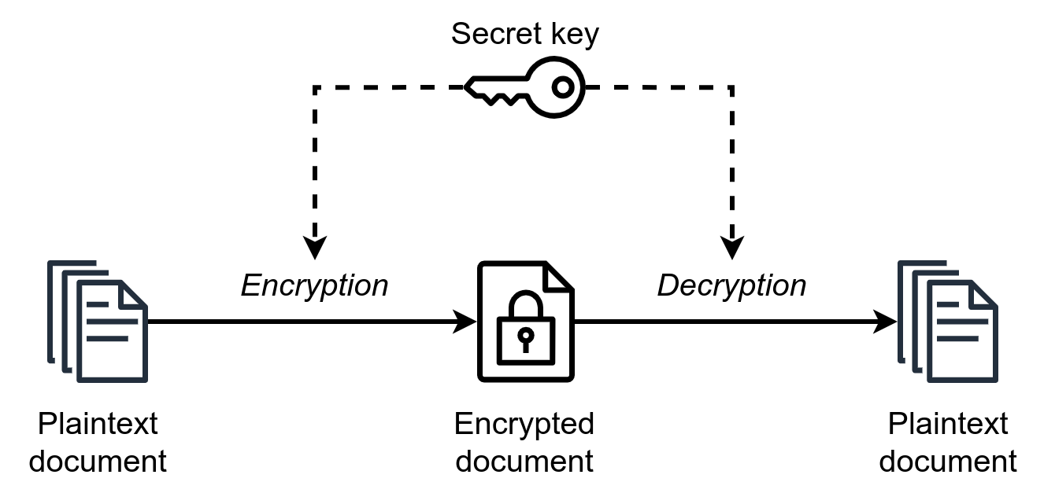

Slide 13
4. BASE64 ENCODING
Definition:
Converts binary data into a text format, allowing for safe transmission over email protocols.
Purpose:
Transforms binary output into a character output, facilitating compatibility with various email systems.
Importance:
Ensures that binary data is preserved during transmission and can be accurately reconstructed by the recipient.
Notes:
Kashish

Slide 14
REAL-WORLD APPLICATIONS OF PEM
Corporate Communications:
Protects sensitive corporate data and communications.
Legal and Financial Transactions:
Safeguards confidentiality in legal documents and financial exchanges.
Personal Privacy:
Secures personal communications for individuals concerned about privacy.
Notes:
Arghadeep

Slide 15
CASE STUDY: RMail
Overview:
Rmail offers secure email services with a focus on encryption and digital signatures.
Features:
Secure message transmission, tracking capabilities, and compliance with privacy standards.
Impact:
Enhances user security, reducing data breach risks and promoting trust in email communications.
Notes:
Sangeet

Slide 16
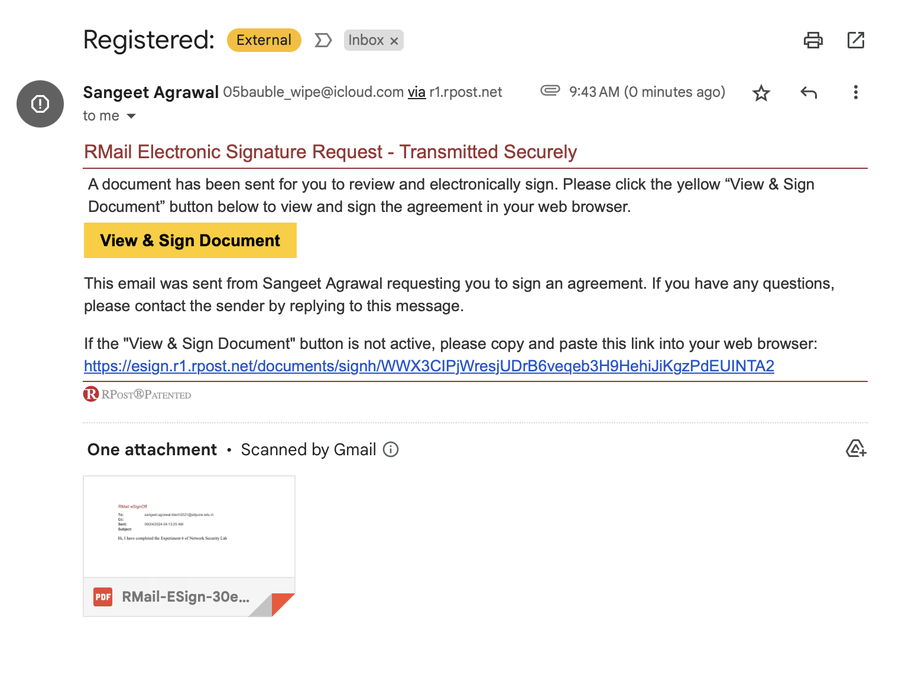

Slide 17
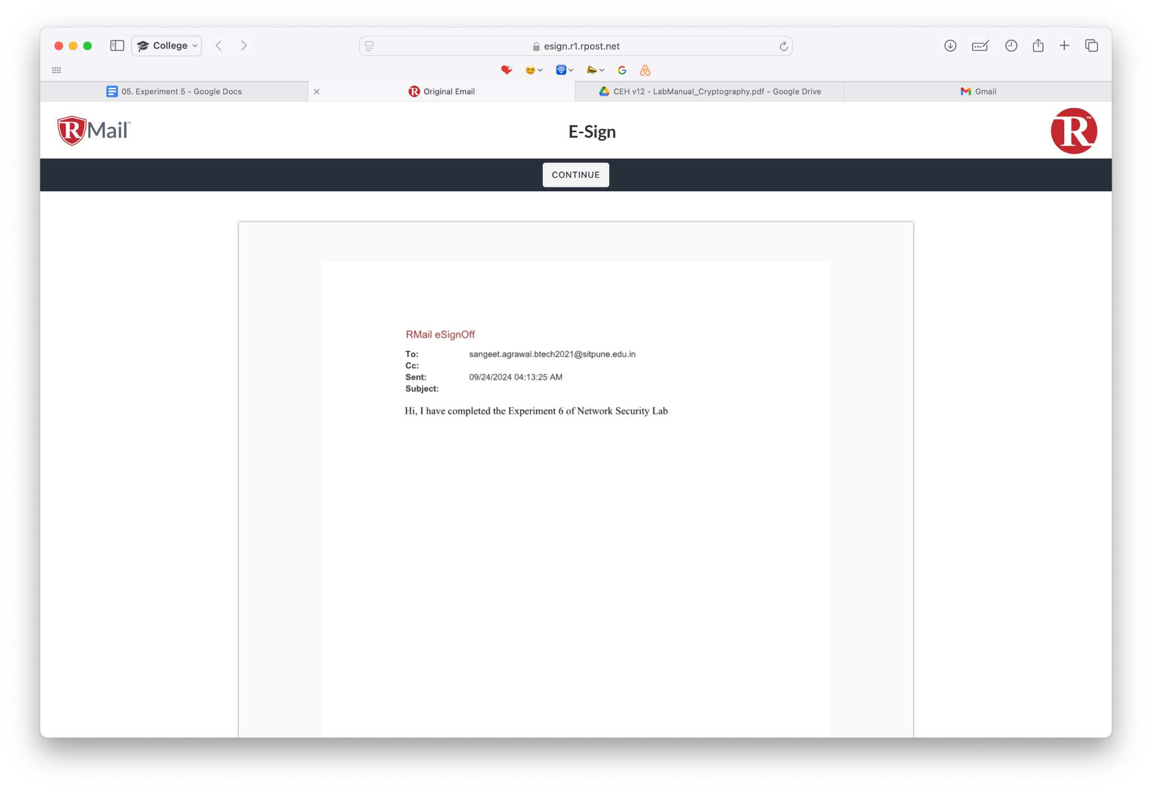

Slide 18
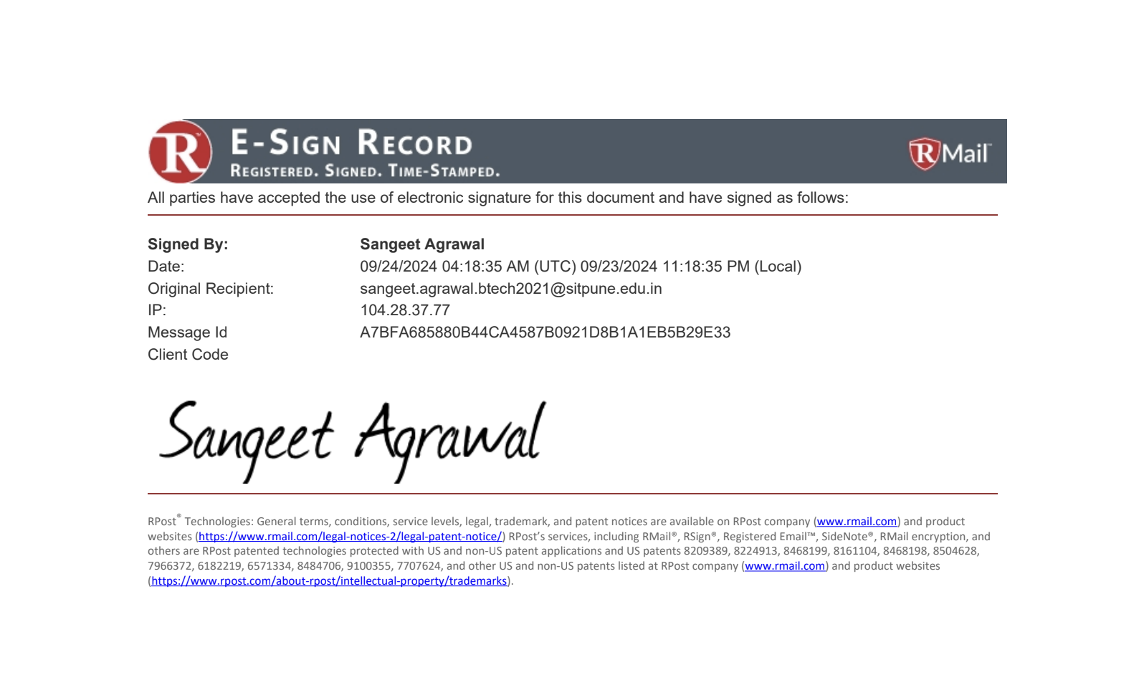

Slide 19
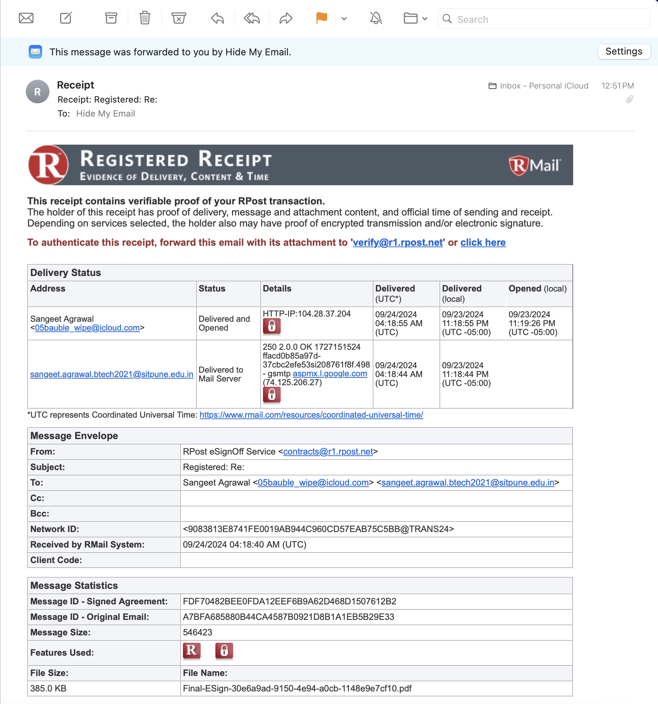

Slide 20
CHALLENGES
Adoption Barriers:
Users may hesitate to switch due to the perceived complexity of implementing PEM protocols.
Interoperability Issues:
Compatibility challenges can arise between different email systems and PEM implementations.
Key Management Difficulties:
Securing and managing encryption keys poses a significant challenge, as lost keys can lead to inaccessible data.
Notes:
Kashish

Slide 21
FUTURE TRENDS
Increasing Emphasis on Secure Solutions:
Growing awareness of cybersecurity risks drives demand for robust email security measures like PEM.
Integration with Advanced Technologies:
Potential incorporation of blockchain and AI to enhance email security and automate threat detection.
User Education and Awareness:
Continuous education on email security practices will be essential for users to effectively utilize PEM and other secure communication protocols.
Notes:
Vaishnavi

Slide 22
SUMMARY
Privacy Enhanced Mail (PEM) is a vital framework for securing email communications.
Core features include confidentiality, integrity, and authentication.
Mechanisms of PEM involve canonical conversion, digital signatures, encryption, and base64 encoding.
Rmail illustrates the practical application of PEM in secure email services.
Adopting standards like PEM is essential for protecting sensitive information in the digital age.
REFERENCES
Privacy Enhanced Mail (PEM) and it’s Working - GeeksforGeeks
Notes:
Vaishnavi

Slide 23
THANK YOU!
Notes:
Vaishnavi

